Slide 1



Akib Akhileshwar Mayank Nithin Ramesh

Slide 2


How It started ?
Its Story time…

Slide 3
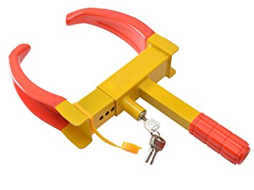





The Problem

Slide 4
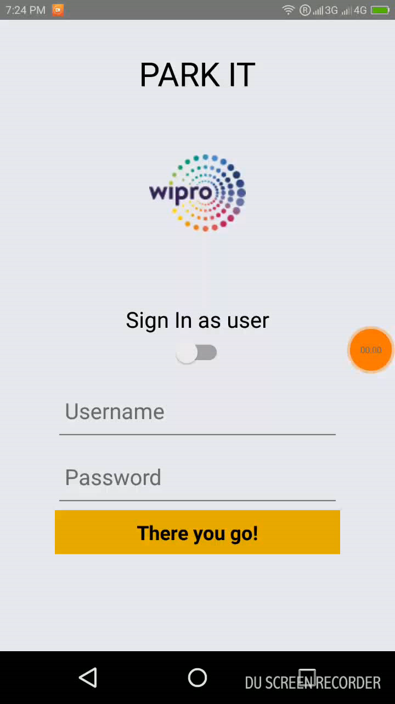

The Solution

Slide 5

Let’s Make It
Park-IT in the Future

Slide 6


